Slide 1


Open Tools for Automated and Scalable Network Testing
AutoCon4 WS:A4
Austin, November 17, 2025
Notes:
UPDATE SLIDE WITH YOUR NAME, TITLE, AND THE DATE
Introduce yourself and your role at Keysight.

Slide 2

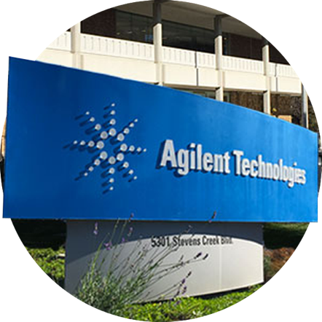



A Brief History of Keysight
+
1939–1998: Hewlett-Packard years
1999–2013: Agilent Technologies years
2014+: Keysight years
2017: Keysight acquires Ixia
Notes:
Ice breaker before the official presentation …
Birthplace of Silicon Valley – Palo Alto Garage – William Hewlett & David Packard
1st Product HP 200A Audio Oscillator 20hz to 20khz
One of first customers – Disney – 8 units at $77.15 each HP 200B
Used to setup Fantasound – what movie? 1940 Animated movie. Fantasia. # discrete sound channels: 8
Clever engineering trick - 15W lightbulb – acted as a low cost variable resistor
Variations sold for 30+ years and in use until 1990s in some labs
Excited to talk about testing AI networks.
Tech Field Day is the first public discussion about our solution though we have been actively working with customers for over 2 years.
1939-1998: A company founded on electronic measurement innovation
1999-2013: Agilent Technologies Years -- Spun off from HP, Agilent became the world’s premier measurement company
In September 2013, it announced the spinoff of its electronic measurement business.
2014- Present: Keysight became an independent company focused on electronic measurement solutions.
2017 – Keysight acquires Ixia.

Slide 3


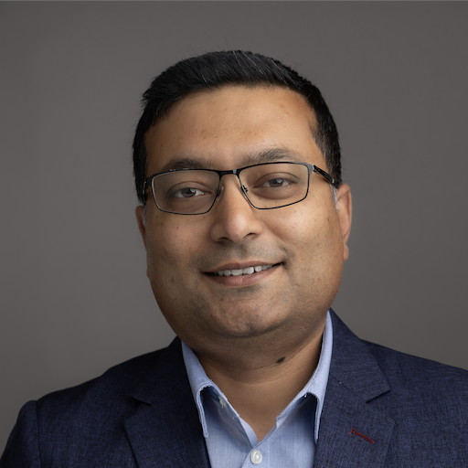
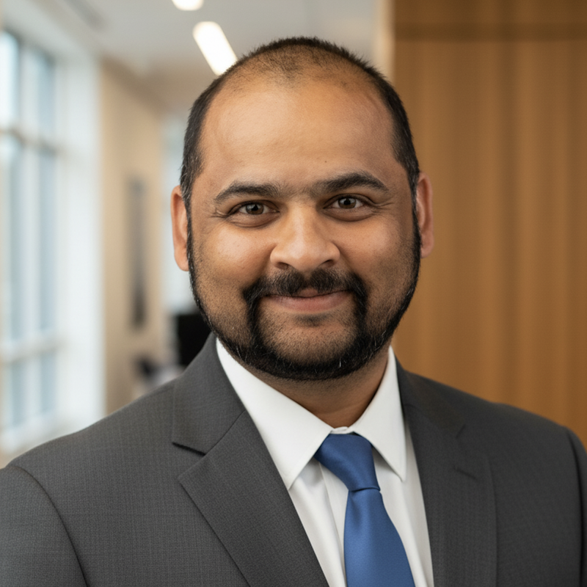

Keysight Network Test Team
Manodipto Ghose (Mano)
Sr. Product Manager
Ashwin Joshi
Sr. Solution Engineer
Octavian Petre (Octav)
Sr. Professional Services Engineer
3
Notes:
Keysight has $5.0 billion in annual revenue. We have over 40,000 customers in more than 100 countries, supported by our employees around the globe. More than 3,800 patents attest to our rich knowledge capital and dedicated investment in cutting-edge R&D. Why should that matter to you? Because we apply all our strengths to one purpose: serving our customers and accelerating innovation to connect and secure the world. This is our company’s mission. And our promise.

Slide 4
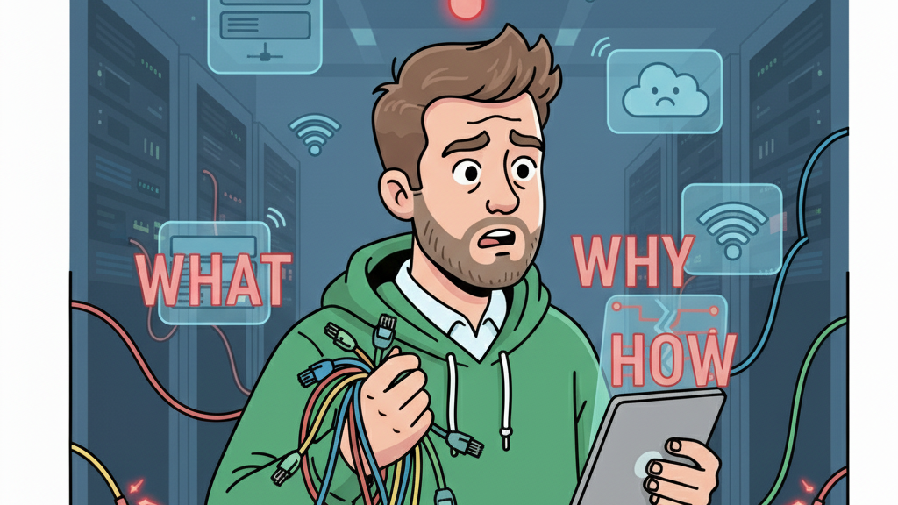
Network Testing

Slide 5
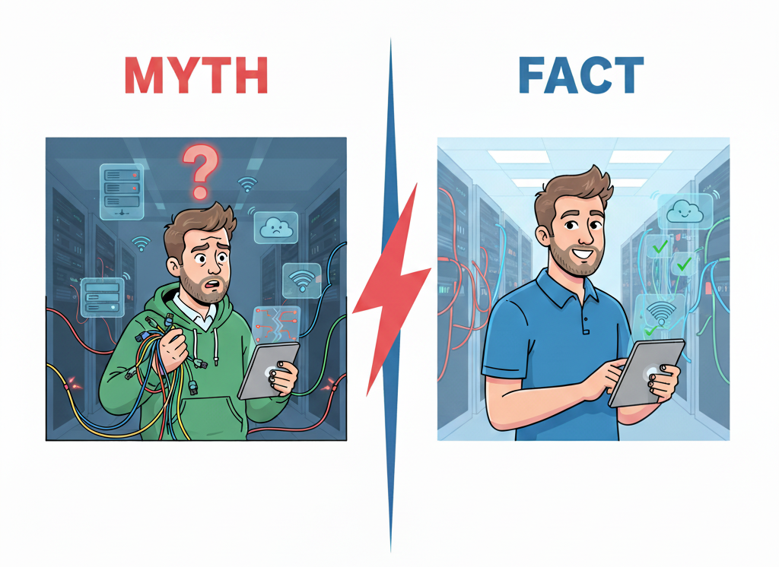
Testing is for engineering not for network operators
Testing is too expensive and time consuming
Traffic generators are a no go in my environment
I need to build a lab infra to replicate our production network
Networks breaking in production is significant revenue loss
Smart and virtualized testing is optimized for everyone
Traffic generators are built to fir all environments and requirements
Traffic generators can also emulate your network to test in emulation

Slide 6




Traffic generator : What and Why
Generate realistic traffic
Control plane emulation
Inject traffic patterns
Test at scale
Routing/Bridging/CPS
Build
Deploy
Operate
Notes:
Mano
Explain traffic generator concept
It is not just a traffic generator but also CP emulator
Not to build an actual network to test a network
Experiment while building, confidence while deploying, and assurance while operating

Slide 7



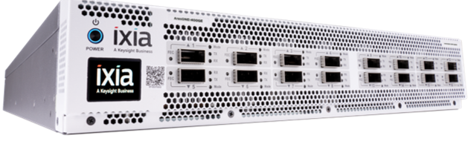
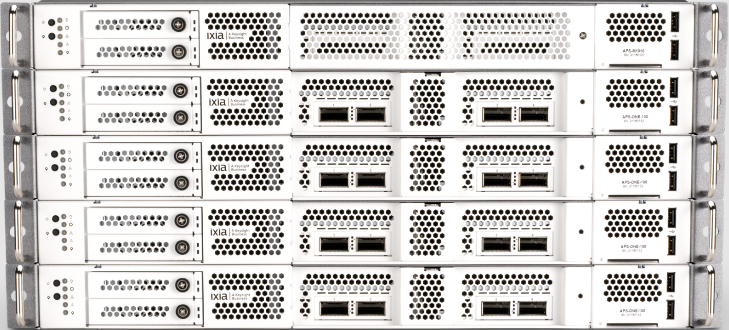
Some popular network test tools
IxNetwork
OTG/KENG
CyPerf
KAI DC builder
Flagship L23 protocol emulation and traffic generator tool
An API based approach to standardize traffic generators
Application and security traffic profiles
Keysight AI datacenter builder
VM/ containers
Hardware
Cloud

Slide 8
Open Traffic Generator

Slide 9



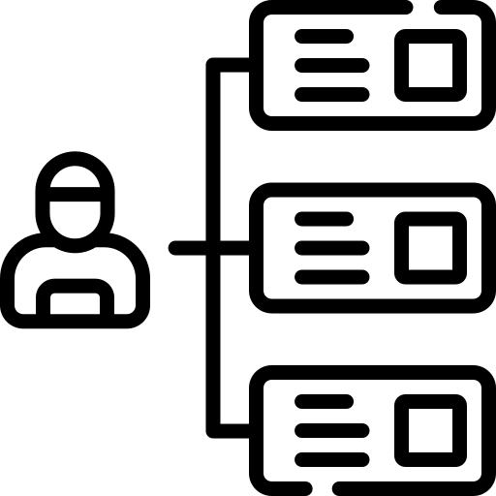

Open Traffic Generator (OTG)
Model-based
Vendor Neutral
Open-API
Use-case driven
Community
Visit https://ixia-c.dev/ and get involved

Slide 10
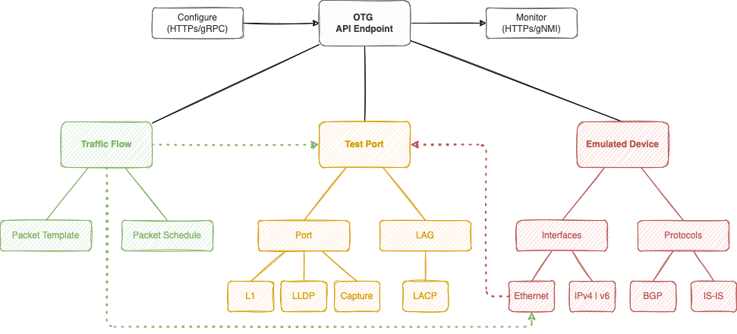
What – OTG Model
https://otg.dev
OTG L2-3 Model Hierarchy

Slide 11
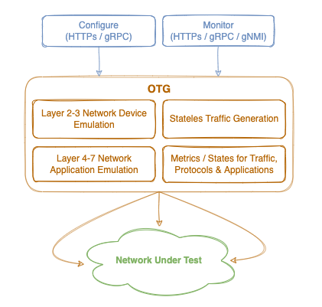
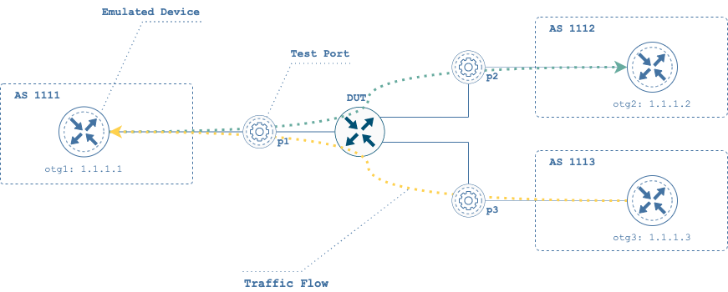
What – OTG API
https://otg.dev
OTG L2-3 Components
Test Ports
Emulated Devices
Traffic Flows
OTG API Surface

Slide 12


Open Traffic Generator API
Data Model / OpenAPIv3
(source of truth)
Client SDKs
(auto-generated)
Test Scripts
(user developed)
Open Traffic Generator APIs
Test Applications
(open or proprietary)
https://otg.dev
Keysight Elastic Network Generator
Test Scripts
Test1.{py,go}
snappi / gosnappi Python / Go Package
(GitHub / PyPI)
Test Scripts
IxNetwork
Open Traffic Generator
Data Models
(GitHub)
TRex
Test Scripts
Test2.{js,cs}
JavaScript, C#, …
Client SDKs
Test Scripts
Magna

Slide 13
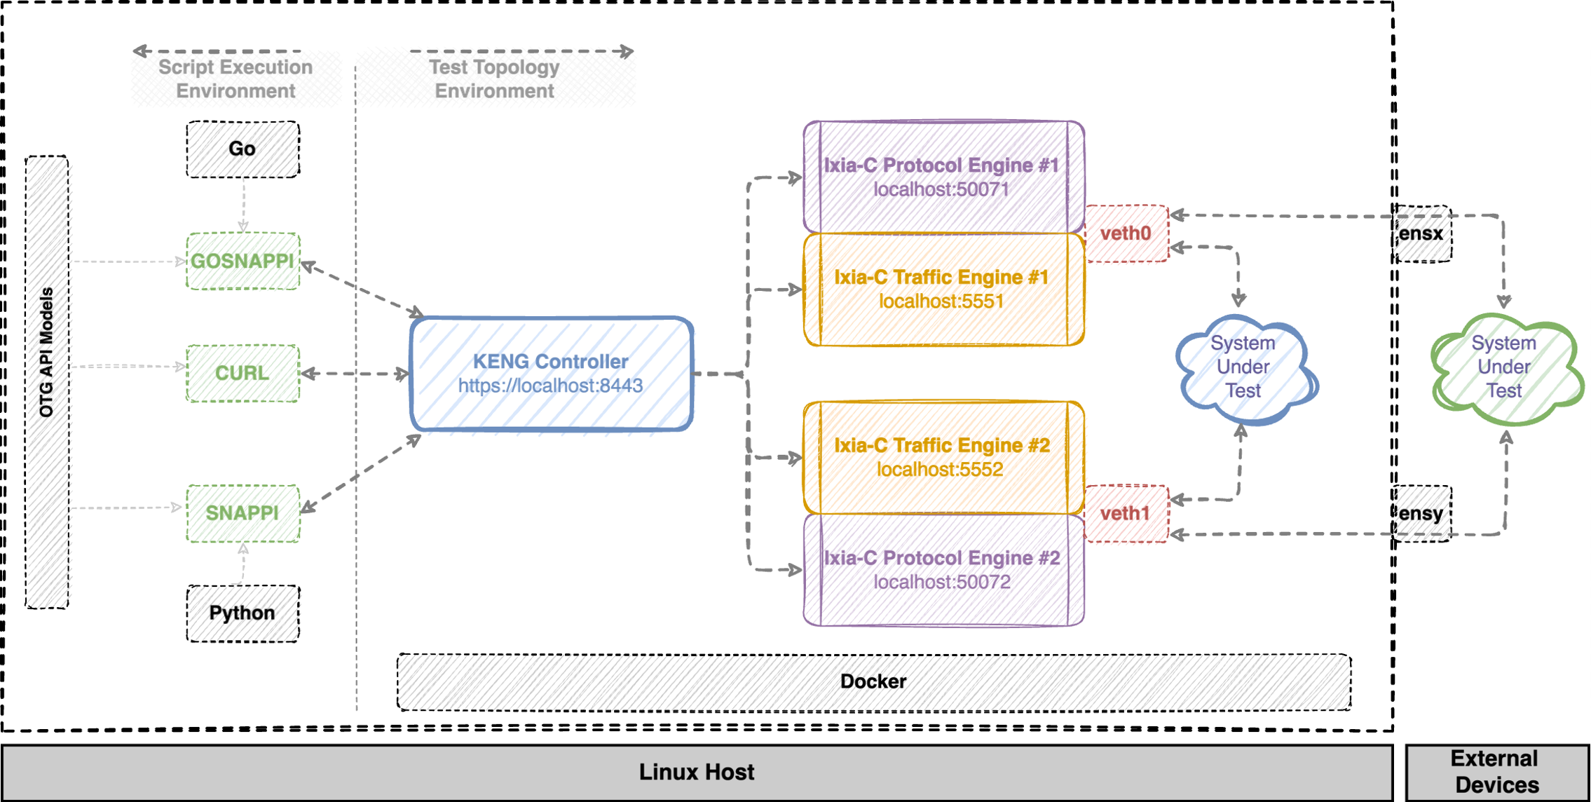




OTG Components
Building blueprint
KENG Controller: The brain which manages all the components
Ixia-c protocol engine: Control plane emulation (BGP, ISIS etc.)
Ixia-c traffic engine: Data plane, traffic flows etc.

Slide 14
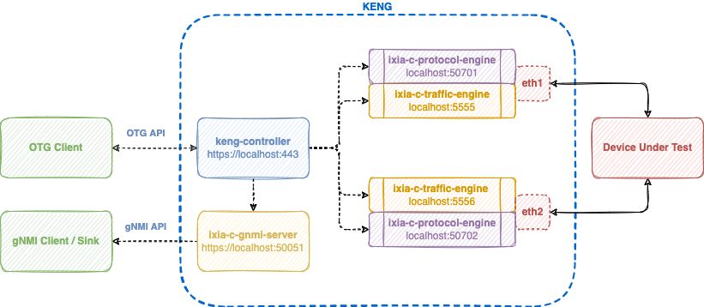
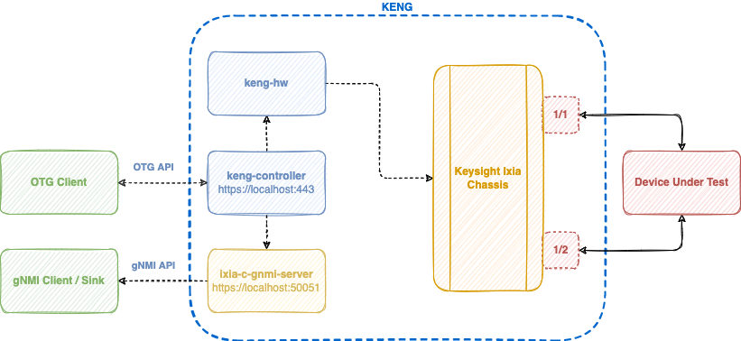
OTG Components continued
Different implementations of OTG
snappi or any REST client
snappi or any REST client
OTG implementation in Ixia-c SW
OTG implementation to Ixia HW

Slide 15
Keysight Elastic Network Generator

Slide 16


Test Program
Keysight Elastic Network Generator
OTG
Keysight OTG UX
User-facing API Endpoint
Write test once, run anywhere
Elastic Network Generator
Ixia-c
Ixia Chassis & Appliances
Generic Compute
Purpose build CPU+FPGA

Slide 17

KENG/OTG learning path
Docs: https://ixia-c.dev/
OTG GitHub Repository: https://github.com/open-traffic-generator
Hands on learning exercises: https://github.com/open-traffic-generator/ac2-workshop
OTG Examples: https://github.com/open-traffic-generator/otg-examples
Quick start with Ixia-c: https://github.com/open-traffic-generator/conformance
Labs (with deployments on different environments):
B2B Ixia-c Traffic
Static B2B LAG
B2B IxOS Hardware
More labs: https://github.com/open-traffic-generator/otg-examples#reference
Ixia-c Slack channel: https://join.slack.com/t/ixia-c/shared_invite/zt-2p11e5yua-u3o1aWzlJcjJquSAqoDk2Q

Slide 18
CyPerf

Slide 19




The CyPerf Advantage
Installable in a Wide Variety of Environments
(VM, Docker, Cloud, Off-the-Shelf)
Highly Performant and Scalable
Realism of Application and Security Traffic
Summary and Detailed statistics

Slide 20





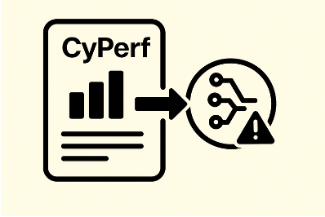
Advantages of CyPerf’s Traffic Emulation
Network Operators use cases
Quantifying Network Latency characteristics, choke points, user QoE
Validating Infrastructure Resilience Against complex Application Workloads
Safely Validating Network Security Postures
Validating Network Scale by Emulating User Scale and traffic Concurrency
Validating network readiness for new AI inferencing and security workloads
Statistics that point to Issues

Slide 21


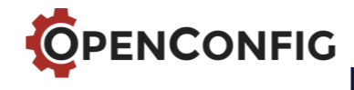





KENG adoption model: OpenConfig project ecosystem
KENG
ONDATRA, Feature Profiles, KNE and HW bindings
Standard Test Infrastructure
(Tools, APIs, Framework)
Common
Criteria
Products
NEMs
Compliance & Benchmarks
NEMs
Network operators
(Hyperscalers, CSP, Telcos)
Vendor ecosystem
(OEMs/NEMs/ASICs)
Test Results
Source of Truth
Non-Compliant
Products
Compliant
Products
Differentiated
Products

